Slide 1

Predicting Term Deposit Subscriptions: A Statistical Analysis of Bank Marketing Data.
GROUP – 6 CHARITHA NALLAKA GEETHIKA SANNALA HARSHITHA DENNIS

Slide 2
CONTENTS
Background and Problem Statement
Key research questions
Data Overview
Data Cleaning
Exploratory Data Analysis
Models
Model Comparisions
Goodness of fit
Conclusion
Future Scope

Slide 3
Key Research Questions to Address Through Our Analysis
Customer Characteristics: What are the key demographic and socio-economic characteristics of customers who subscribe to the bank’s term deposit?
Campaign Effectiveness: What factors influence the success of the marketing campaign? Are certain types of communication (e.g., phone calls, emails) more effective?
Time-Related Analysis: Are there specific times of the year, month, or day that show higher success rates for term deposit subscriptions?

Slide 4
DATA OVERVIEW
The dataset contains 45,153 rows and 17 columns.
Target variable: y (whether the customer subscribed to a term deposit).
Categorical Variables: Job, marital, education, default, housing, loan, contact, month, poutcome and y.
Numerical Variables: Age, balance, day, duration, campaign, pdays, and previous

Slide 5
DATA CLEANING
NO MISSING VALUES
NO DUPLICATES

Slide 6
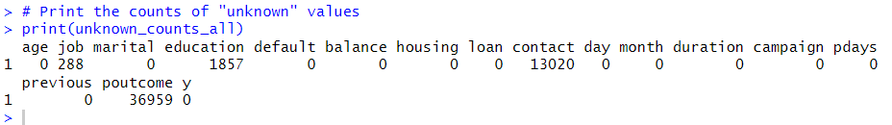
DATA ISSUES
Dropped column poutcome due to a high number of "unknown" values (36,959), making it unreliable for analysis.
Dropped previous as it is similar to campaign.
Used an imputation strategy that leverages the mode (most frequent value) within groups to handle missing values.
Imputed missing values for the job, education, and contact columns by replacing them with the most common value within each group.
Ensures that the imputed values are contextually relevant and preserves the relationship between variables.
Maintains the integrity of the data distribution and prevents the introduction of bias.
Imputed values are realistic and representative of the actual data.
Leads to more accurate and reliable analysis and modeling.

Slide 7
OUTLIERS
FEATURE | OUTLIERS
Age | 487
Balance | 4729
Duration | 3235
Campaign | 3064
Pdays | 8257
Age and Balance: Outliers in age and balance might be real data points representing important information.
For pdays I am leaving it as is because it represents the number of days since the last contact with the client, which is an important feature that reflects temporal information. Imputing it could distort its meaning or relationship with the target variable.
Capping the outliers in both the campaign and duration variables helps prevent extreme values from skewing the model. For campaign, this ensures that additional contacts beyond a certain point have the same effect, while for duration, it limits the impact of unusually long or short durations that could distort the results.

Slide 8
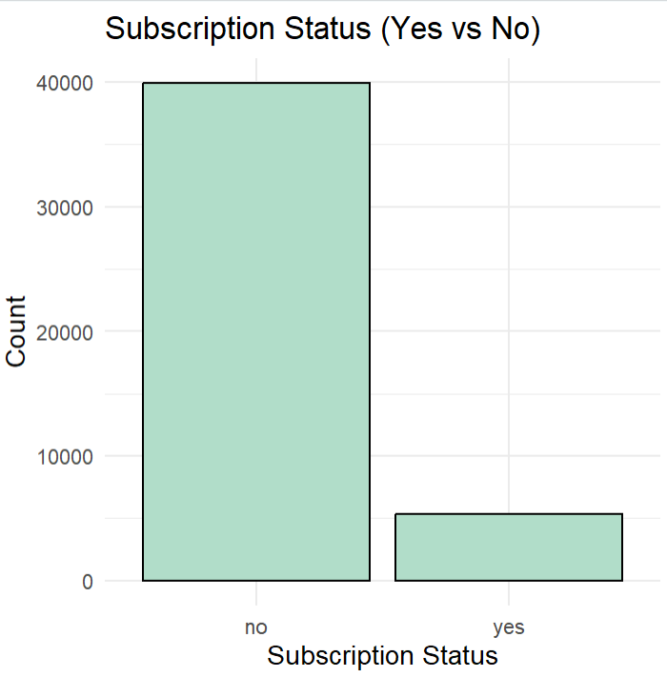
IMBALANCE
Random oversampling is a technique used to balance the class distribution by duplicating instances of the minority class.
It helps improve model performance by allowing the model to learn from both classes, enhancing metrics like accuracy, precision, recall, and F1 score.
This method reduces bias, preventing the model from favoring the majority class and ensuring better performance on the minority class.
By balancing the dataset, it ensures an equal or nearly equal number of samples for both classes, leading to fairer and more reliable predictions.

Slide 9
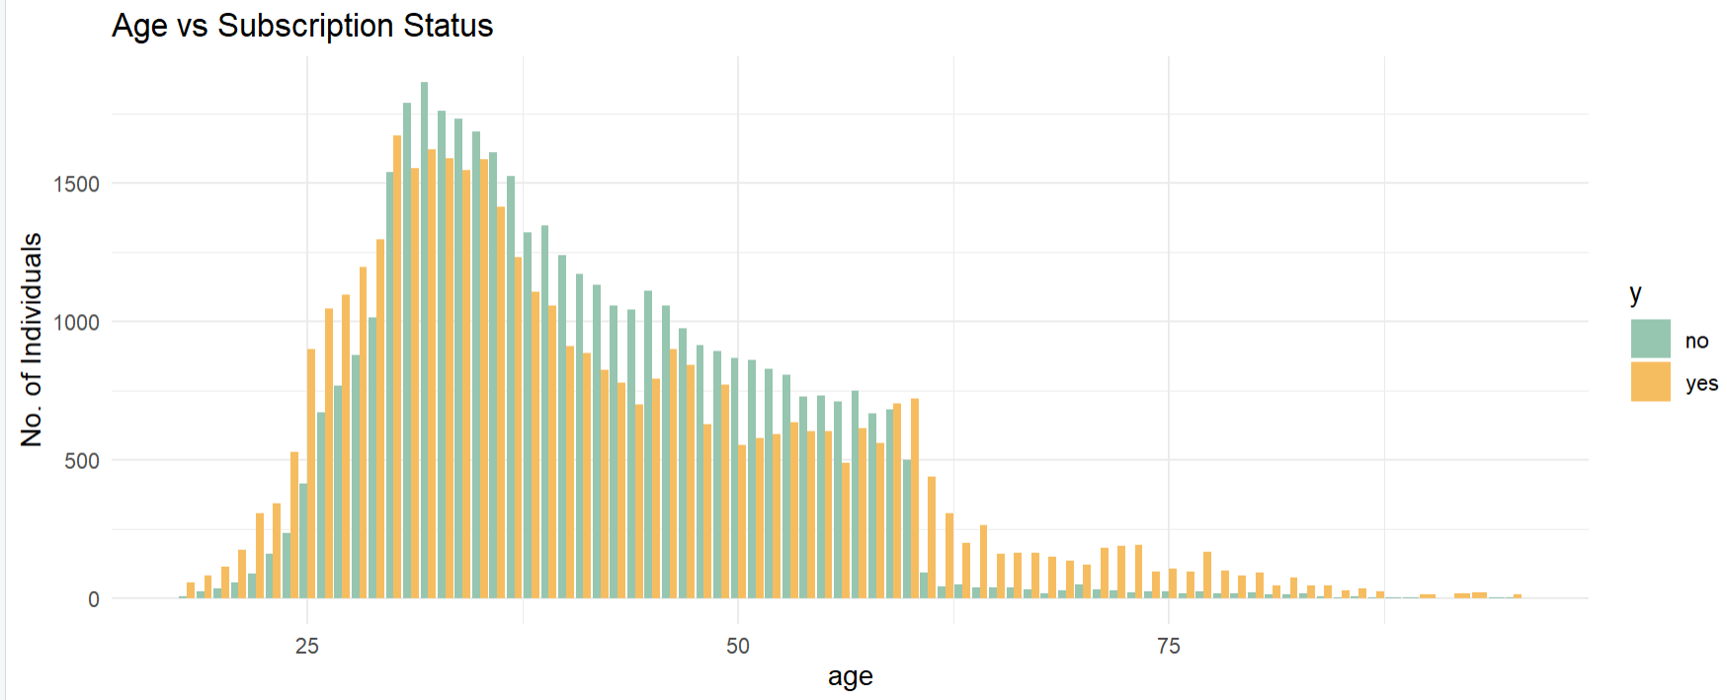
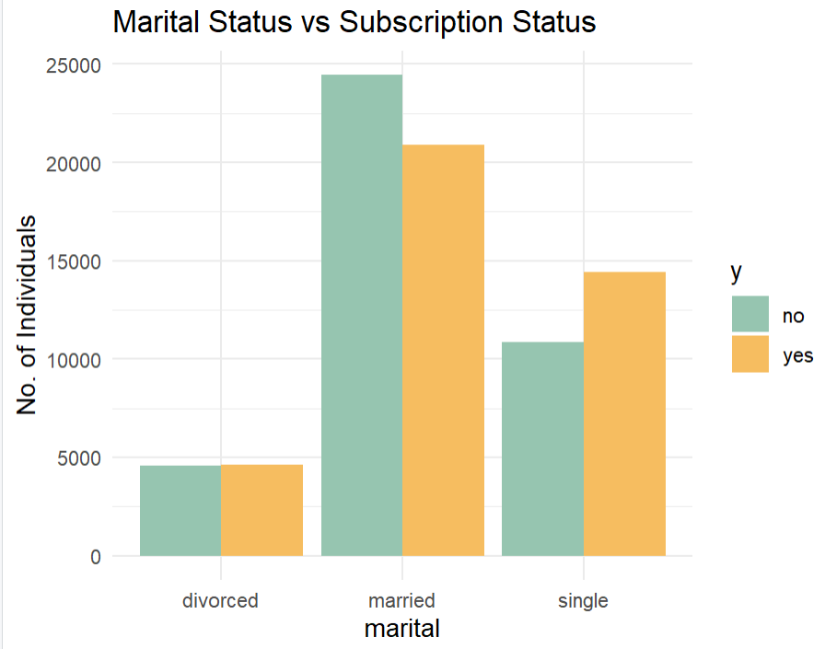
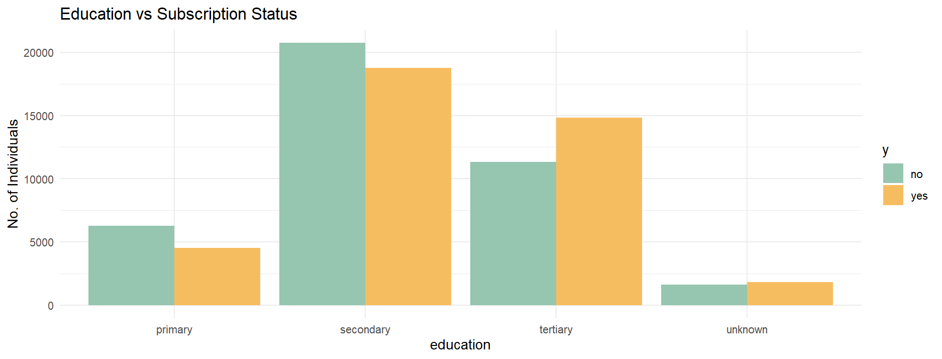
IMPACT OF DEMOGRAPHIC FACTORS ON SUBSCRIPTION STATUS

Slide 10
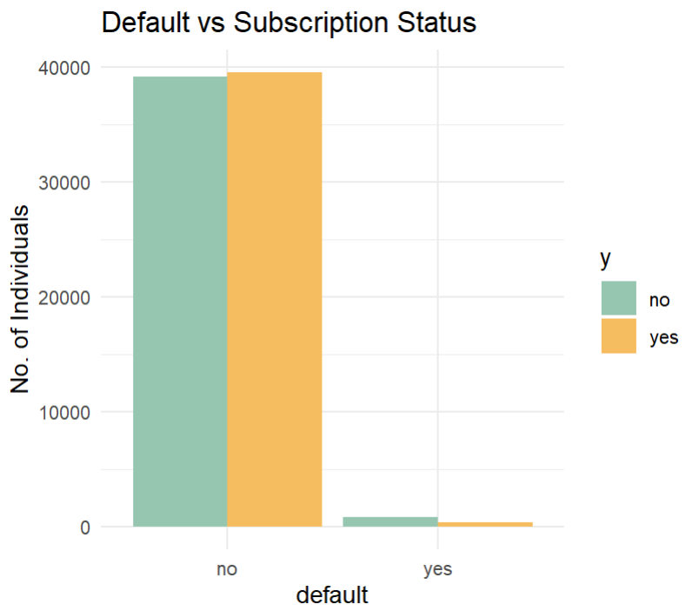
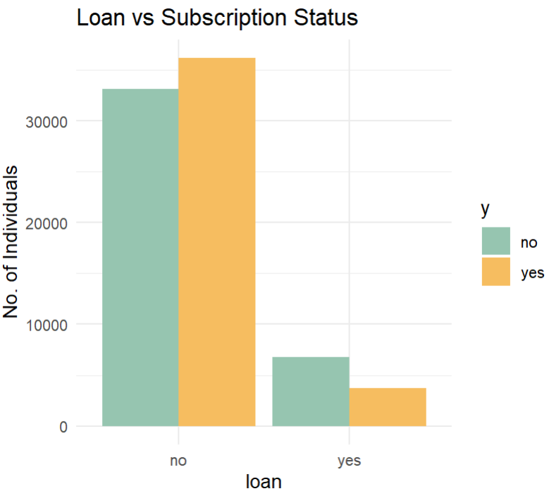
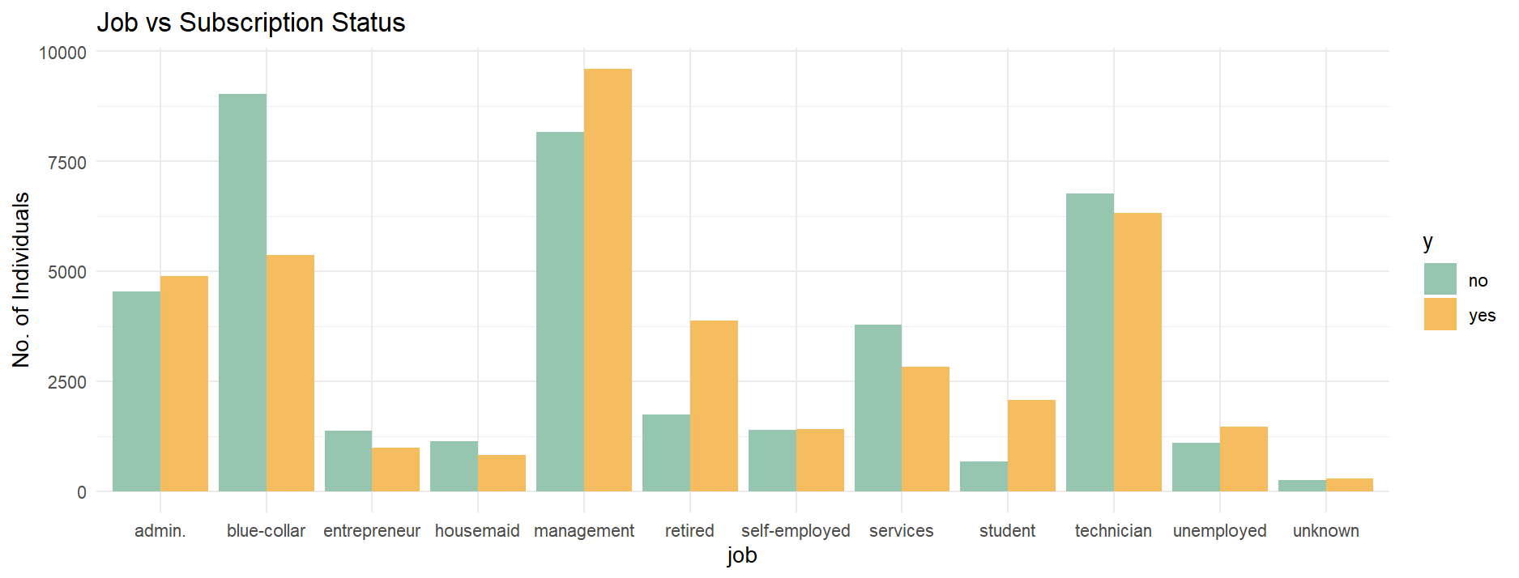
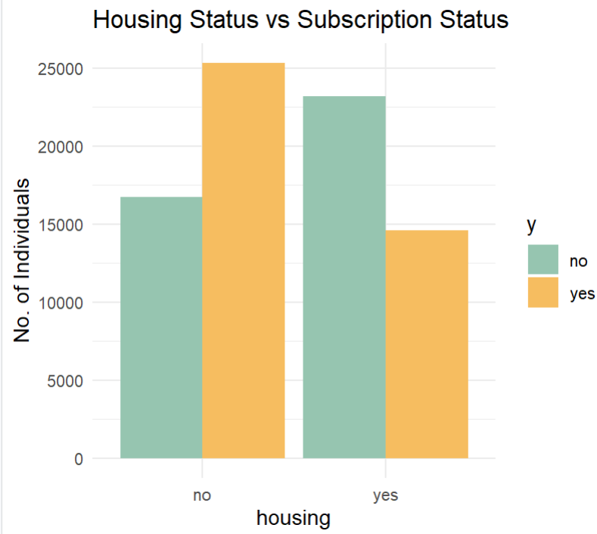
IMPACT OF SOCIO-ECONOMIC FACTORS ON SUBSCRIPTION STATUS

Slide 11
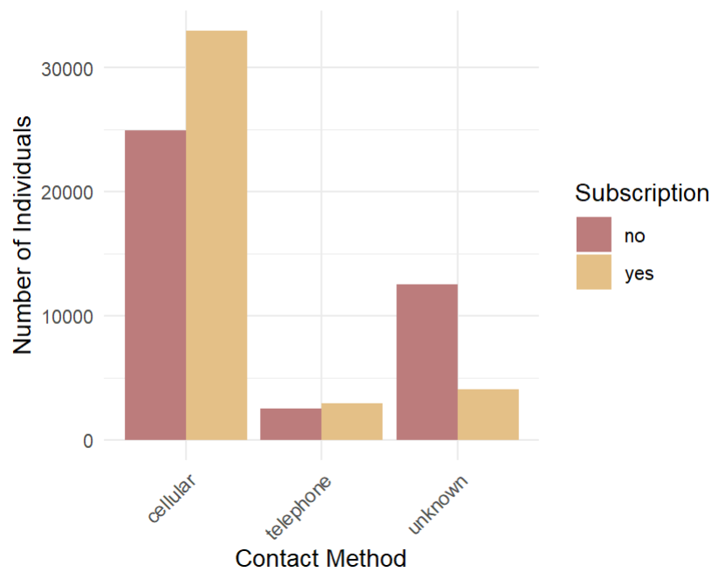
IMPACT OF CONTACT METHODS ON CAMPIGN SUCCESS
Key Insights:
Cellular Contact Dominates: Cellular contact is the most effective method, reaching a higher number of individuals, with a larger proportion of subscribers compared to non-subscribers.
Telephone Contact Less Effective: Telephone contact reaches fewer individuals, and the number of subscribers is noticeably lower compared to non-subscribers.
Unknown Contact Method Least Effective: The "unknown" contact method is the least effective, reaching the smallest number of individuals, suggesting the need for better targeting and more accurate contact data.
Takeaway:
Focus on prioritizing cellular contact to maximize outreach and improve subscription rates. Consider refining the unknown category to enhance targeting accuracy.

Slide 12
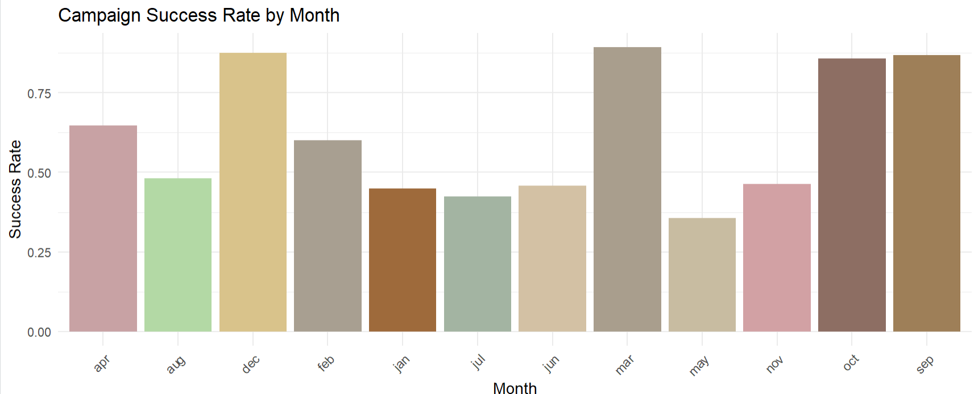
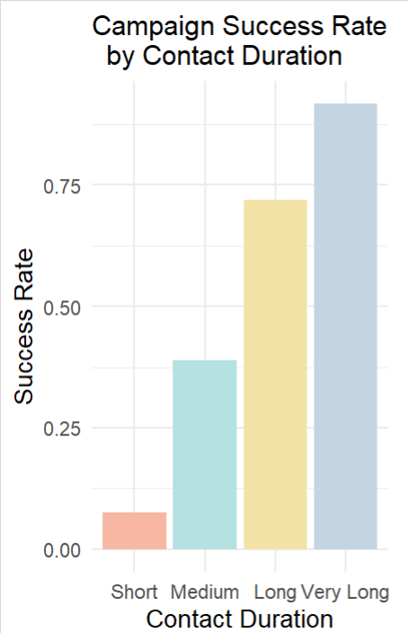
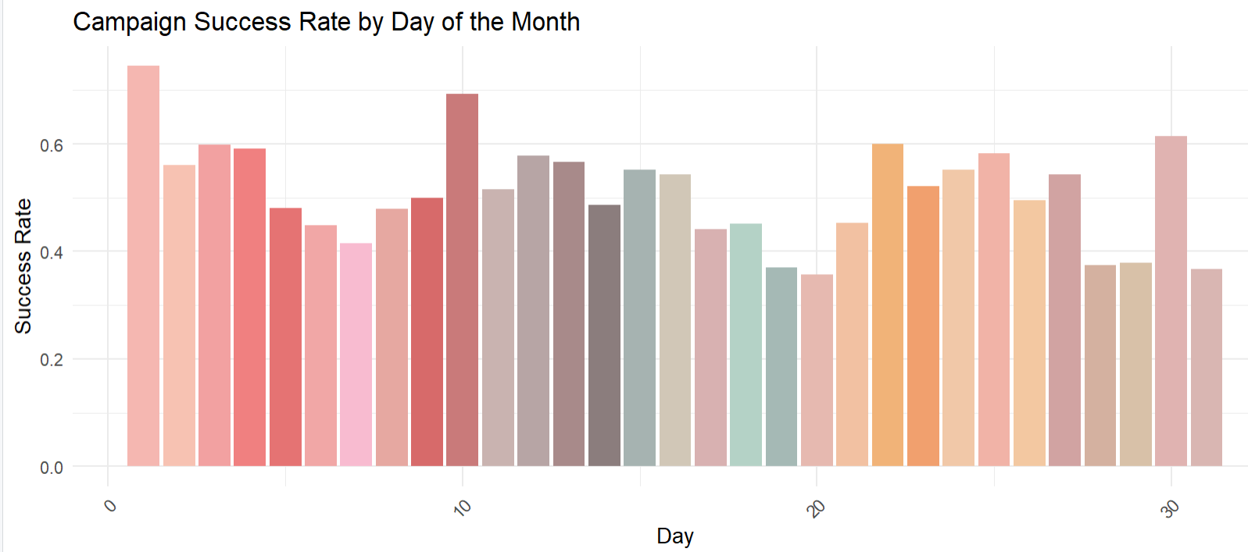
IDENTIFYING KEY PERIODS FOR HIGH SUBSCRIPTION SUCCESS

Slide 13
ENCODING CATEGORICAL VARIABLES
Job: blue-collar, entrepreneur, housemaid, management, retired, self-employed, services, student, technician, unemployed, unknown
Marital: married, single
Education: secondary, tertiary, unknown
Default: yes, no
Housing: yes, no
Loan: yes, no
Contact: telephone, unknown
Month: aug, dec, feb, jan, jul, jun, mar, may, nov, oct, sep
Poutcome: other, success, unknown
Age_Group: Adults, Middle-aged, Old-aged
Duration_Category: Medium, Long, Very Long
Used One hot Encoding to encode categorical variables
Represents categorical variables as binary vectors, avoiding assumptions of ordinal relationships between categories.
Improves model performance by allowing algorithms to process categorical data without bias or implied ranking.
Suitable for algorithms like logistic regression, which we are using in our case, as it allows the model to interpret categorical variables without assuming any ordinal relationships.

Slide 14
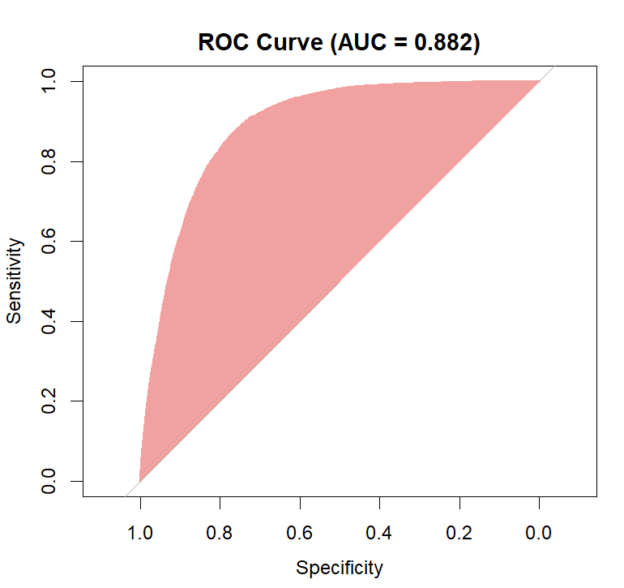
BASELINE MODEL: GLM WITH ALL FEATURES
 | Predicted: 0 (Not subscribed) | Predicted: 1 (subscribed)
Actual: 0 (Not subscribed) | 32399 (TN) | 7427 (FP)
Actual: 1 (subscribed) | 7523 (FN) | 32495 (TP)
SUMMARY OF GOOD AND BAD PREDICTORS
Good Predictors (Significant with p < 0.05)
job types (blue-collar, entrepreneur, housemaid, management, self-employed, and student), education levels (secondary and tertiary), balance, housing and loan status (both "yes"), contact type (unknown), months (March and October), duration, previous contacts, poutcome success, age groups (adults and middle-aged), and duration categories (medium and long)
Bad Predictors (Insignificant with p > 0.05) marital status (single), month of February, and pdays.
MODEL EVALUATION METRICS
Accuracy: 81.28% (Proportion of correct predictions).
Precision (Positive Predictive Value): 81.2% (Proportion of predicted positives that are actually positive).
Recall (Sensitivity / True Positive Rate): 81.4% (Proportion of actual positives correctly predicted).
F1 Score: 81.3% (Harmonic mean of Precision and Recall).
MODEL FIT STATISTICS
AIC (Akaike Information Criterion): 67573 (Indicates the quality of the model lower AIC is better).
Null Deviance: 110687 (Deviance of the model with no predictors).
Residual Deviance: 67499 (Deviance of the fitted model).
Difference in Deviance: 43188 (Model improvement compared to null).

Slide 15
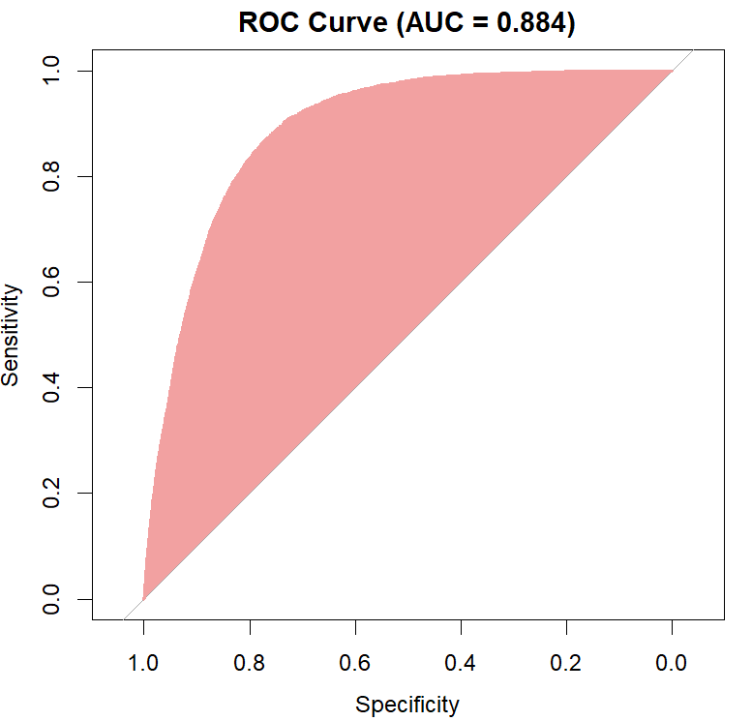
BACKWARD ELIMINATION MODEL: WITH STEP AIC
 | Predicted: 0 (Not subscribed) | Predicted: 1 (subscribed)
Actual: 0 (Not subscribed) | 32406 (TN) | 7394 (FP)
Actual: 1 (subscribed) | 7516 (FN) | 32528 (TP)
SUMMARY OF GOOD AND BAD PREDICTORS
Good Predictors (Significant with p < 0.05)
age, several job types (blue-collar, entrepreneur, housemaid, management, retired, self-employed, services, student, technician, unemployed, and unknown), marital status (married), education levels (secondary, tertiary, and unknown), balance, housing status (yes), loan status (yes), contact type (unknown), day, various months (August, December, January, July, June, March, May, November, October, and September), duration, campaign, previous contacts, poutcome (other, success, and unknown).
Bad Predictors (Insignificant with p > 0.05) marital status (single), month of February, pdays.
MODEL EVALUATION METRICS
Accuracy: 81.97% (Proportion of correct predictions).
Precision (Positive Predictive Value): 81.3% (Proportion of predicted positives that are actually positive).
Recall (Sensitivity / True Positive Rate): 81.47% (Proportion of actual positives correctly predicted).
F1 Score: 81.34% (Harmonic mean of Precision and Recall).
MODEL FIT STATISTICS
AIC (Akaike Information Criterion): 67573 (Indicates the quality of the model lower AIC is better).
Null Deviance: 110687 (Deviance of the model with no predictors).
Residual Deviance: 67501 (Deviance of the fitted model).
Difference in Deviance: 43186 (Model improvement compared to null)

Slide 16

COMPLEX MODEL : WITH INTERACTION TERMS
 | Predicted: 0 (Not subscribed) | Predicted: 1 (subscribed)
Actual: 0 (Not subscribed) | 32512 (TN) | 7179 (FP)
Actual: 1 (subscribed) | 7410 (FN) | 32743 (TP)
SUMMARY OF GOOD AND BAD PREDICTORS
Good Predictors (Significant with p < 0.05)
age, several job types (blue-collar, entrepreneur, housemaid, management, retired, self-employed, services, student, technician, unemployed, and unknown), marital status (married), education levels (secondary, tertiary, and unknown), balance, housing status (yes), loan status (yes), contact type (unknown), day, various months (August, December, January, July, June, March, May, November, October, and September), duration, campaign, previous contacts, poutcome (other, success, and unknown), age groups (adults, middle-aged, and old-aged), and duration categories (medium and long).
Bad Predictors (Insignificant with p > 0.05) marital status (single), month of February, pdays.
MODEL EVALUATION METRICS
Accuracy: 82.18% (Proportion of correct predictions).
Precision (Positive Predictive Value): 81.55% (Proportion of predicted positives that are actually positive).
Recall (Sensitivity / True Positive Rate): 82.02% (Proportion of actual positives correctly predicted).
F1 Score: 81.78% (Harmonic mean of Precision and Recall).
MODEL FIT STATISTICS
AIC (Akaike Information Criterion): 66997 (Indicates the quality of the model lower AIC is better).
Null Deviance: 110687 (Deviance of the model with no predictors).
Residual Deviance: 66873 (Deviance of the fitted model).
Difference in Deviance: 43814 (Model improvement compared to null).

Slide 17
MODEL COMAPARISION
Model 1: Slightly underperforms in accuracy, recall, and AUC compared to the other models, but still provides balanced precision and F1 score.
Model 2: Shows competitive performance with minimal differences from Model 3, especially in precision and recall, but slightly trails in overall classification ability (AUC).
Model 3: Outperforms the other models in all key metrics, including accuracy, precision, recall, F1 score, and AUC, making it the most reliable model overall.
METRIC | MODEL 1 | MODEL 2 | MODEL 3
Accuracy | 81.28% | 81.97% | 82.18%
Precision | 81.2% | 81.3% | 81.55%
Recall | 81.4% | 81.47% | 82.02%
F1 Score | 81.3% | 81.34% | 81.78%
AUC | 0.882 | 0.884 | 0.892

Slide 18
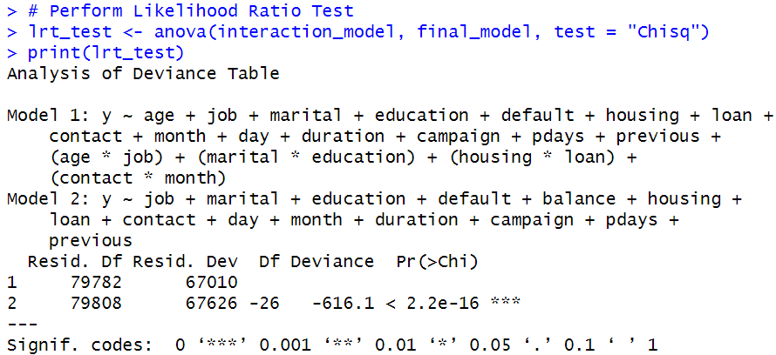
GOODNESS OF FIT
Model 3 (Interaction model) provides a significantly better fit than Model 2 (final model without interaction terms).
The Chi-square statistic is 616.1 with 26 degrees of freedom, and the p-value is < 2.2e-16, indicating a highly significant result.
The deviance difference of -616.1 confirms the improvement in model fit with interaction terms.
The reduction in deviance is statistically significant, validating that including interaction terms improves the model's performance.
DEVIANCE ANALYSIS
Null Deviance: 110,687 (79,843 degrees of freedom)
Residual Deviance: 67,010 (79,782 degrees of freedom)
Deviance Reduction: 43,677
DF Difference: 61 (Small reduction in degrees of freedom, suggesting relevant predictors without overfitting)
Deviance to DF Ratio: 0.83(fits well no complex)
LIKELIHOOD RATIO TEST
AIC AND BIC
 | MODEL 1 | MODEL 2 | MODEL 3
AIC | 67573 | 67564 | 66997
BIC | 67929 | 67929 | 67559
Model 3 has the lowest AIC (66,997) and BIC (67,559) among all three models, indicating it provides the best fit among the three models.

Slide 19
KEY FINDINGS FROM ODDS RATIO
GOOD PREDICTORS (Positive Association) | BAD PREDICTORS (Negative Association) | Neutral Predictors (No Association)
Month March : 6.99 | Job retired: 0.01 | Age job blue-collar: 0.99
Month December: 4.45 | Job blue collar: 0.99 | Age job technician: 1.00
Month October: 3.34 | Job Unemployed: 0.76 | Marital single: 1.00
Month September: 3.18 | Contact telephone month may: 0.49 | Education secondary: 0.97
Housing No :1.67 | Marital single education secondary: 1.18 | Default yes: 0.62
Contact telephone month jun: 2.15 |  | Campaign: 0.90
Contact telephone month aug: 1.24

Slide 20
CONCLUSION
Based on the analysis, we drawn several key conclusions regarding the factors influencing the success of the bank’s marketing campaigns and customer subscriptions to term deposits. Our model, which achieved an accuracy of 82.18%, provides strong predictive capabilities and insights.
Targeted Marketing:
Focus marketing efforts on customers around 30 years old, particularly those who are married , and have secondary or tertiary education.
Highlight the benefits of term deposits to customers in management, blue-collar, technician, and administrative occupations.
Effective Communication:
Prioritize cellular communication for marketing campaigns.
Train call center agents to engage in longer, more informative conversations with potential customers to increase conversion rates.
Timing of Campaigns:
Schedule intensive marketing efforts during the high-success months of December, March, September, and October.
Plan to boost communication at the beginning, mid-week, and end of each month to align with customers' financial cycles.
Continuous Improvement:
Regularly update and refine the predictive model to maintain high accuracy and adapt to changing customer behaviors and market conditions.

Slide 21
Future Scope and Actions to Enhance the Predictive Model
Incorporate Additional Data Sources:
Collect financial behavior data from internal bank records or credit bureaus.
Gather demographic and lifestyle data from market research firms or customer surveys.
Preprocess and integrate this new data into the existing dataset for analysis.
Use Advanced Modeling Techniques:
Experiment with ensemble models and neural networks.
Train and evaluate models using cross-validation.
Implement Real-Time Prediction:
Develop a real-time system for instant recommendations.
Set up a streaming data pipeline using frameworks like Apache Kafka.
Enhance Model Interpretability:
Utilize SHAP values and LIME to explain model predictions.
Generate reports for actionable insights.

Slide 22
Thank you

Slide 23
QUESTIONS?

